Slide 1


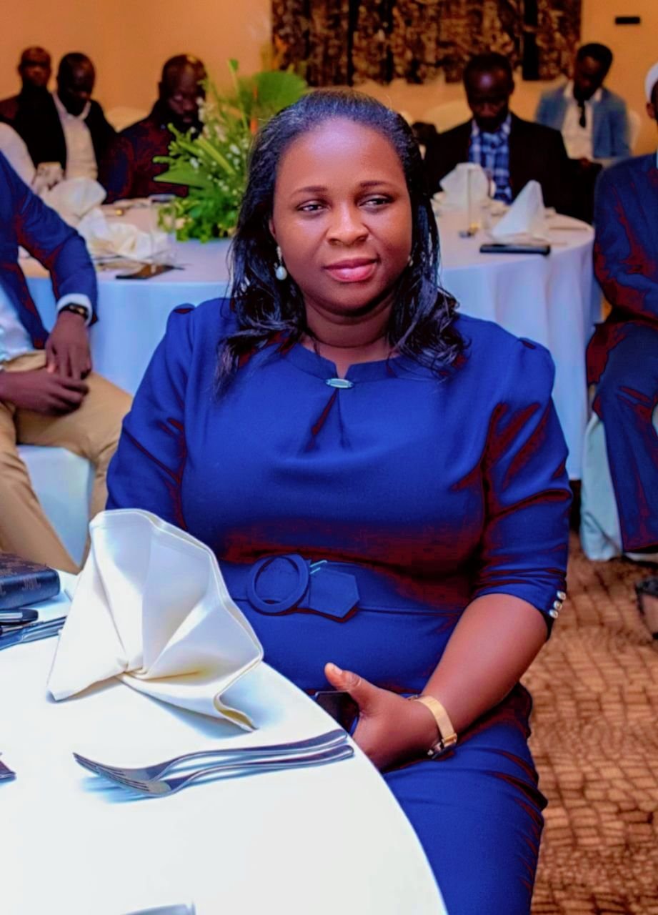
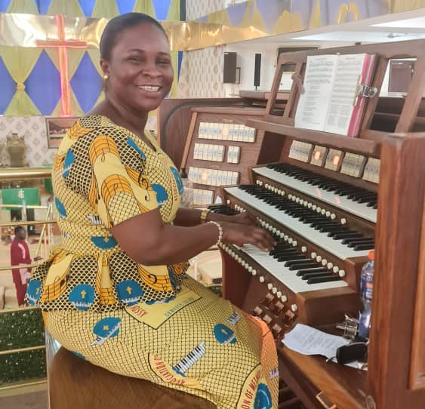
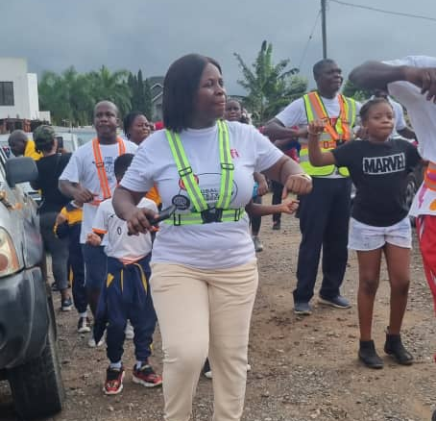
Getting to Know Me
Work
Personal
My role
Accounts Relationship/External Affairs Manager. Admin. Head – ofi Ghana. GROW Finance Council Lead.
Significant others / family members / furry friends in my life
Kweku Obrempong Asamoah Mensah.
ASP Joshua Nana Brako.
Tenure in ofi/Olam
18 Years
How I enjoy spending my free time
Attending Choir Practice and Spending quality time with family.
Previous companies I have worked at
Metaprod Aluminum Company.
My favorite / comfort food
Fufu & Chicken Light soup, Rice & Palava sauce.
Why I joined ofi/Olam and what keeps me here?
Ofi/Olam offered me the opportunity to grow in my career. The recognition, inclusive leadership and the Exposures gained during execution of my role keep me in ofi.
My favorite song
Inspirational songs.
Sylvia Arthur
Sylvia
Sylvia is a Self-motivated, Fair and Instrumental Team player.
Sylvia loves music/singing, dancing, cooking and serving family with healthy/delicious meals.
This is me outside work, doing stuff I enjoy in my life …

